Slide 1
MIS 637 Amazon choice Prediction Model
Course: MIS637 (Spring 2019)
Prepared by: Rushabh Doshi
Guided by : Prof. Mahmoud Daneshmand

Slide 2
Introduction
One of Amazon many great strengths is the sheer breadth of its inventory. The retailer is said to stock hundreds of millions of different products, with everything from fishing rods to dog food in its virtual aisles.
But that degree of choice can be overwhelming, too: If you're shopping for, say, wireless headphones, you've got over 3,000 models from which to choose.
All things being equal, you might go for the one that has the "Amazon's Choice" label on it.
Amazon's Choice items are becoming more important as these are the items Amazon's search engine will deliver when you ask Alexa, Amazon's voice-shopping service, to search for you.
In this problem we will be discussing how to predict whether a product would be tagged with Amazon’s Choice
When users typing keywords in searching box, the website will return a list of products that is relevant to the keywords.
There will be only one product that is labelled with Amazon’s Choice.

Slide 3
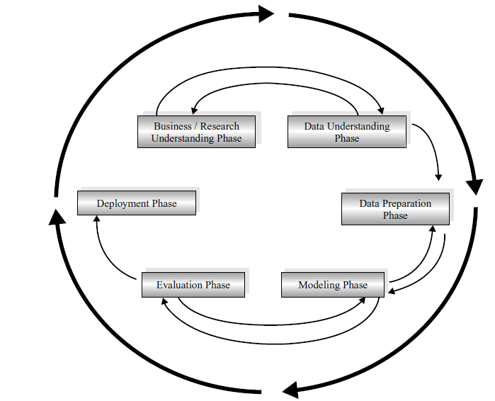
CROSS-INDUSTRY STANDARD PROCESS (CRISP–DM)
Business understanding phase.
Data understanding phase
Data preparation phase
Modeling phase
Evaluation phase
Deployment phase

Slide 4
Business Understanding
Question:
How to use extracted data from amazon site and apply various machine learning algorithm to predict which product would be tagged as Amazon’s Best Choice Product
Goal:
Once the user enters the keywords of their desired products, a list appears with many products but only one will be Amazon’s Best Choice Product so we will be predicting that product for the user
Accomplishments:
By using this Machine Learning model we can predict which item can be marked as amazon’s best choice in individual category. This solution can be very helpful to customers in shopping the best items in individual category.

Slide 5
Data Understanding
Source of the Data:
•Extracted data for “Amazon`s Choice” (60000 products) from Amazon`s website and classified them using Python.
•Used LDA technique to understand crucial factors for any user and filtered them for final dataset.
Details of the Dataset:
Number of rows : 10265

Slide 6
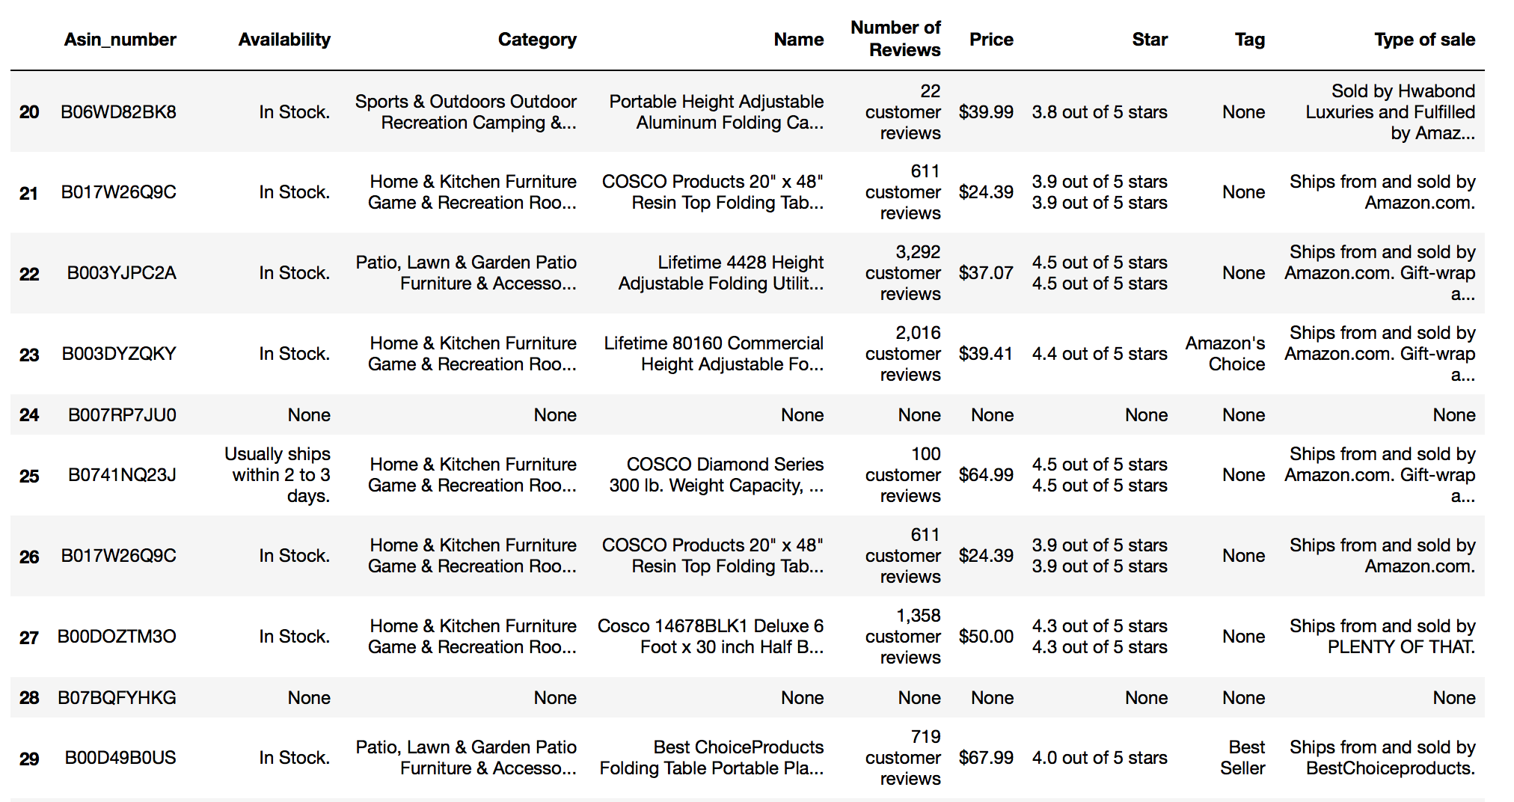
Data Understanding – sample data

Slide 7
Data Understanding
Attribute details:
Asin_number: random generated number
Availability: Check if the product is in stock or not.
Category: In which category the product belongs.
Name: The name of the product
Number of reviews: How many views the product has till date.
Price: The price of the product.
Star: How many stars people have who have used that product
Tag: These specifies the product category in which it belongs.
Type of sale: which company is selling that product on amazon.

Slide 8
Data Preparation
Data preparation is the process of cleaning and transforming raw data prior to processing and analysis.
It is an important step prior to processing and often involves reformatting data, making corrections to data and the combining of data sets to enrich data.
After collecting the data the steps which remains are
1. Cleanse and validate data
2. Transform and enrich data
3. Store data

Slide 9
Data Preparation
Tag was transformed to reflect 1 for ‘Amazon’s Choice’ and 0 for others.
Star and number of reviews were transformed to show the number alone by removing the other text.
$ was removed from the price column to retain only the numeric value.
Availability, Category and Type of sale were label encoded for the purpose of building the models.
Asin_number was made the index as it is unique for each product.

Slide 10
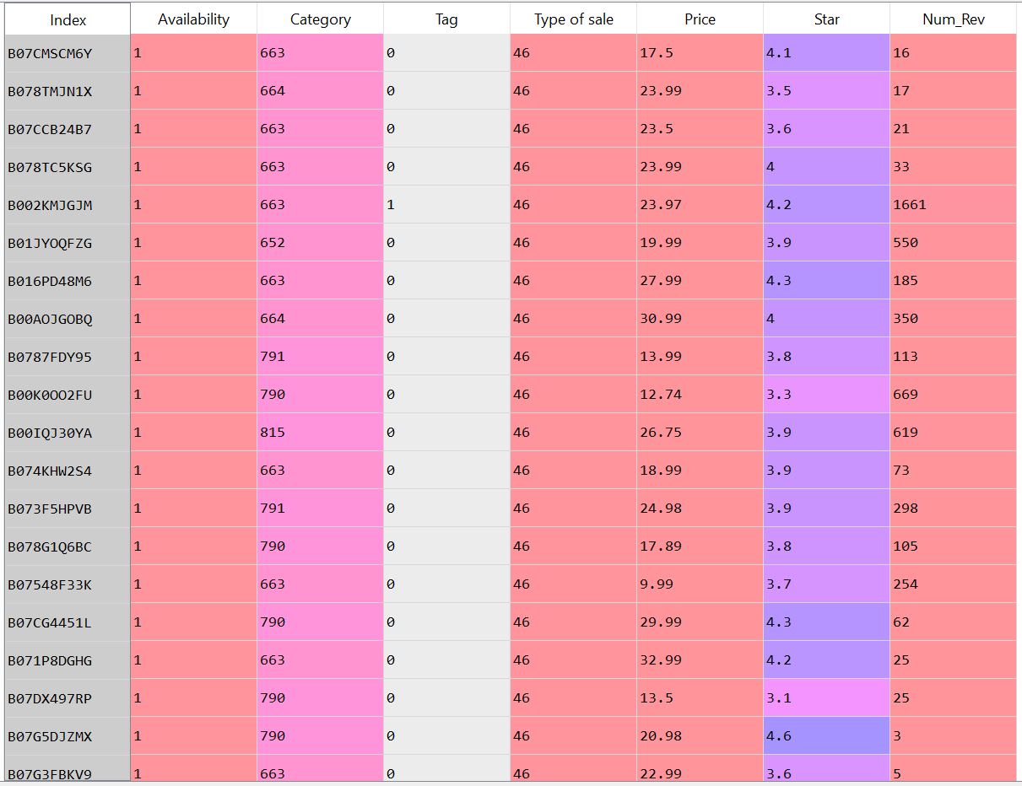
Data Preparation

Slide 11
Data Preparation
Data division:
After the data is cleaned it can be divided into training and testing dataset.
Training data set: 80% of the data, is used to train the model.
Testing data: 20% of the data is used to test the efficiency of our developed model.

Slide 12
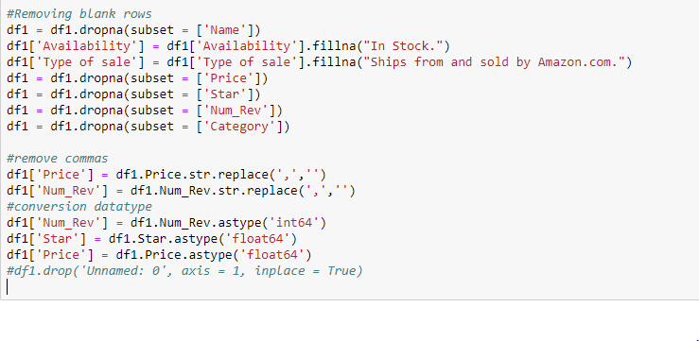
Data Cleaning

Slide 13
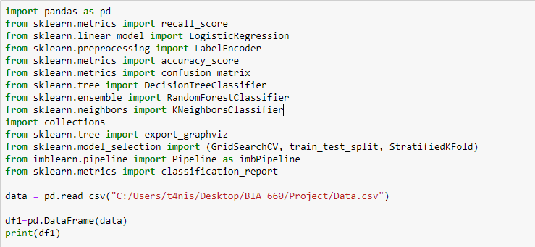
Libraries used

Slide 14
Data Modeling
In this project various modeling techniques are applied.
Typically, there are several techniques used are as follows
Logistic Regression
K-Nearest Neighbour
Decision Tree
Random Forest

Slide 15
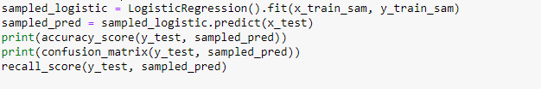
Data Modeling - Logistic Regression
Logistic Regression is shown here
We can see it predicts 157 number of True positives
Using this dataset, we applied different classification algorithms and compared the result
Using Cross Validation inside a pipeline we cross validate the results.

Slide 16

Logistic Regression
Output after refitting the model with cross validation result

Slide 17
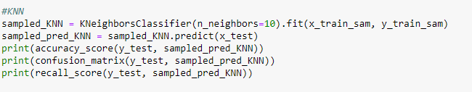

Data Modeling - KNN
After refitting, we can see a Rise in True Positives and a drop in True Negatives

Slide 18


KNN
The accuracy score and the confusion matrix for KNN
Accuracy and confusion matrix after refitting

Slide 19

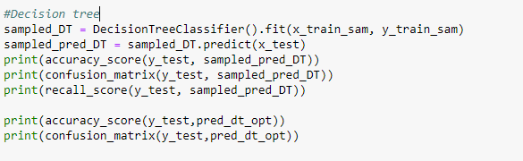
Data Modeling – Decision Tree
Overfitting of the Model is corrected after cross validation
Accuracy score and Confusion matrix of Decision Tree

Slide 20

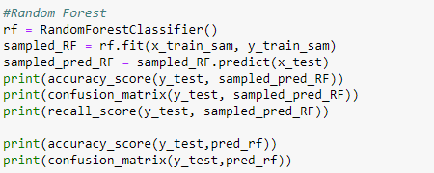
Data Modeling – Random Forest
Accuracy score and Confusion matrix of Random Forest

Slide 21
Evaluation
Comparing the True Positives for Random forest to the other algorithms, we can conclude saying that
Decision Tree gives us the best model to predict Amazon’s choice
While Random forest tends to be biased

Slide 22
Deployment
The model produced an accuracy of about 91% which is good but it can be increased even more before this model is actually deployed in the industry.
For example the efficiency of this model can be improved if more data is added to the dataset or if we get more attributes that can help us in the decision making.

Slide 23
References
https://www.businessinsider.com/what-is-amazons-choice-2018-5
https://www.python.org/downloads/
https://www.amazon.com/

Slide 24
Thank you !

